Slide 1
OOPS

Slide 2
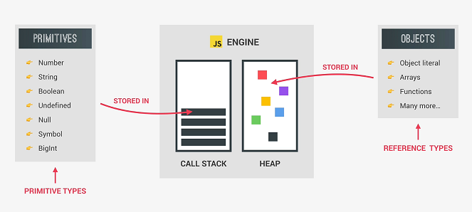
Datatypes:

Slide 3
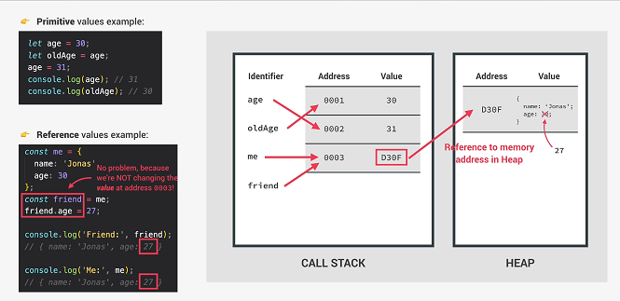
Primitive vs Reference Types

Slide 4
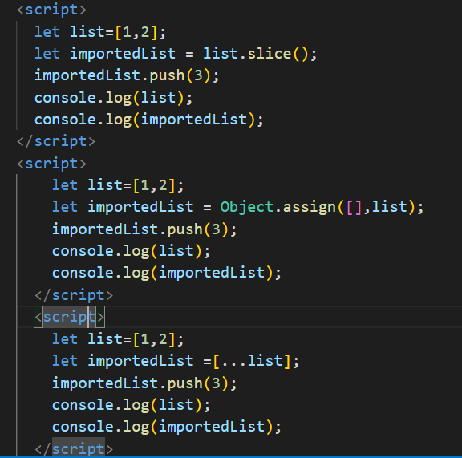
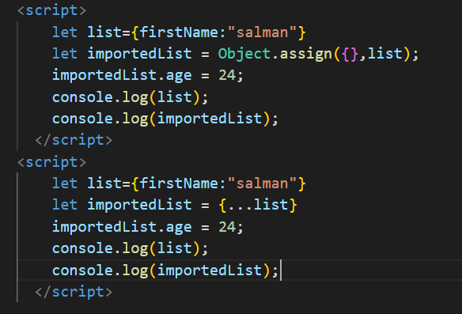
Deep copy of Array and Object

Slide 5
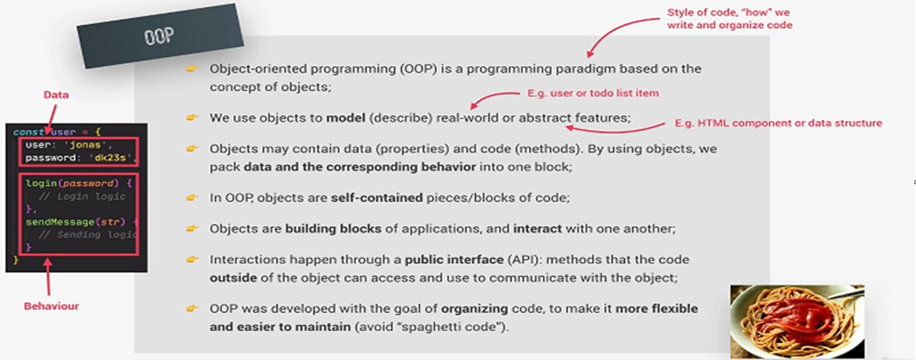
Object Oriented Programming

Slide 6
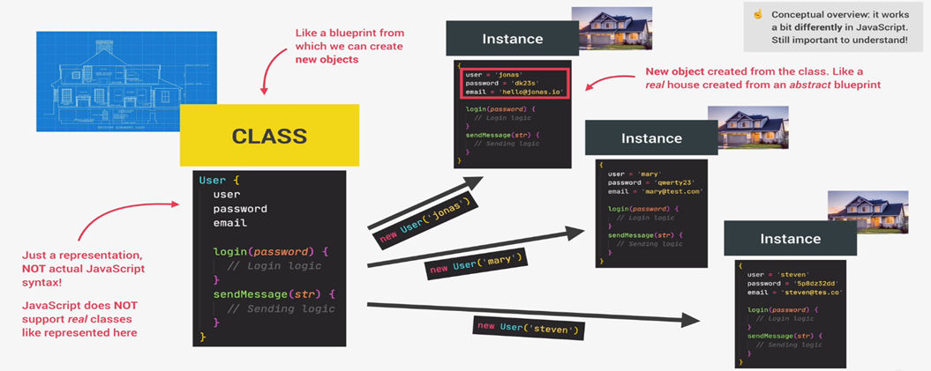
Classes And Instances

Slide 7
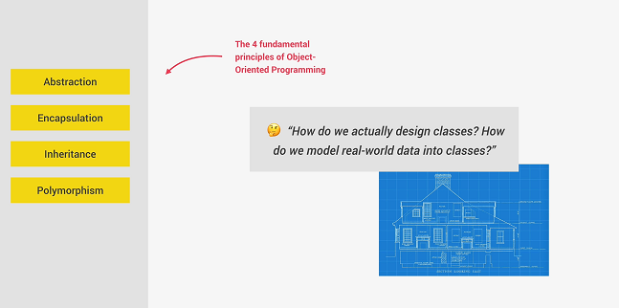
Fundamental of OOPS

Slide 8
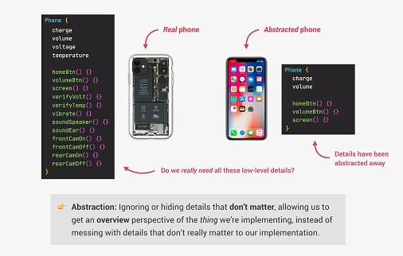
Abstraction

Slide 9
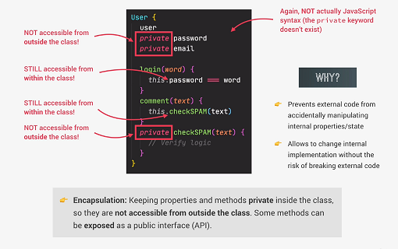
Encapsulation

Slide 10
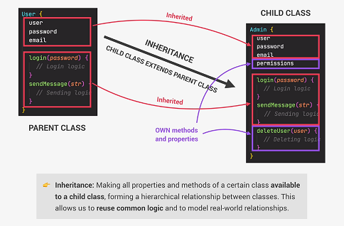
Inheritance

Slide 11
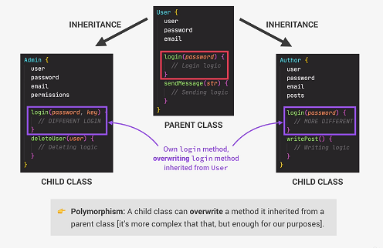
Polymorphism

Slide 12
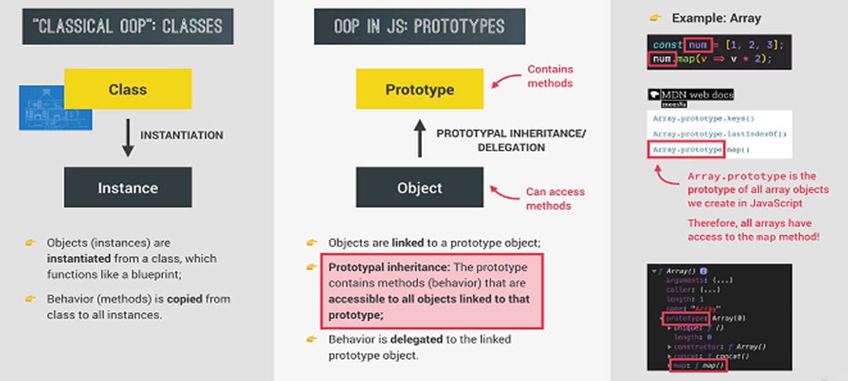
OOPS in Javascript

Slide 13
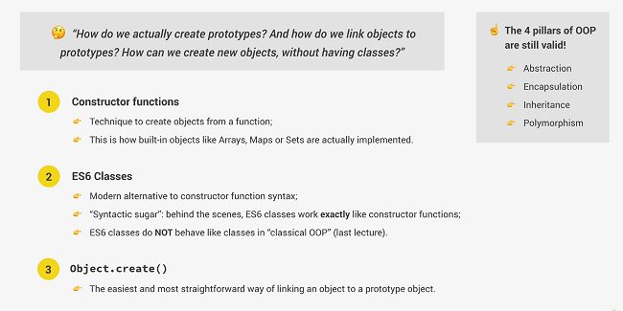
3 Ways of Implementing Prototypal Inheritance in Javascript

Slide 14
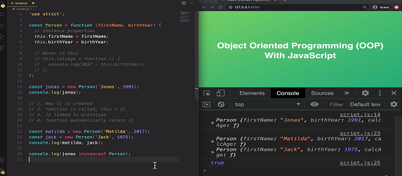
Constructor Function

Slide 15
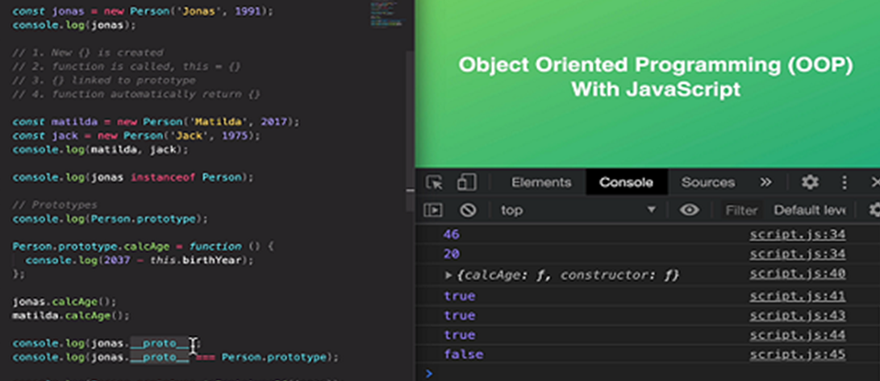
Prototypes

Slide 16
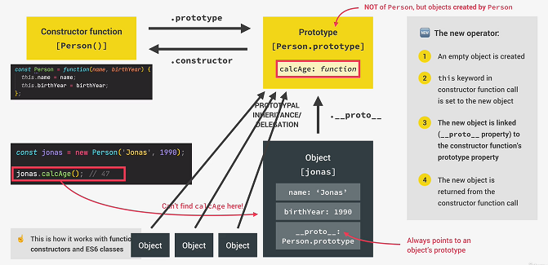
How Prototypal Inheritance

Slide 17
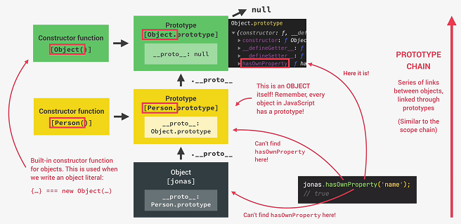
Prototype Chain

Slide 18
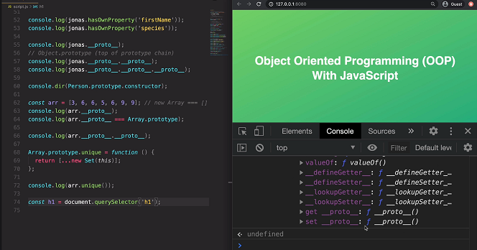
Prototypal Inheritance on Built in Objects

Slide 19
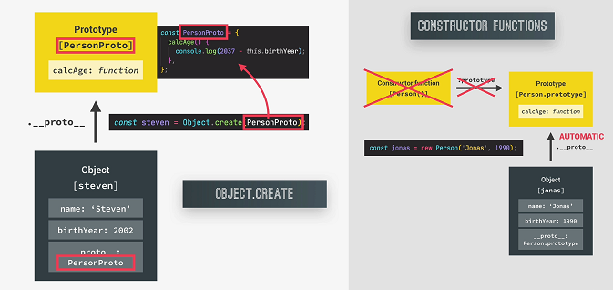
How Object.create Works

Slide 20
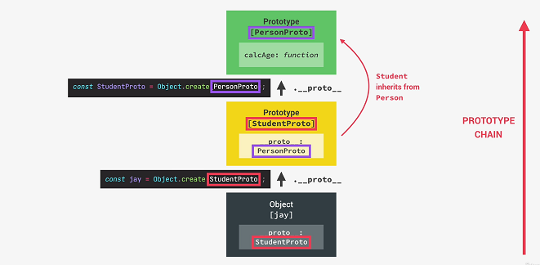
Inheritance in Object.create

Slide 21
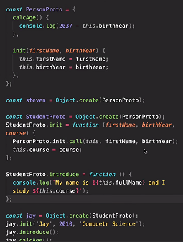
Inheritance – Object.create

Slide 22
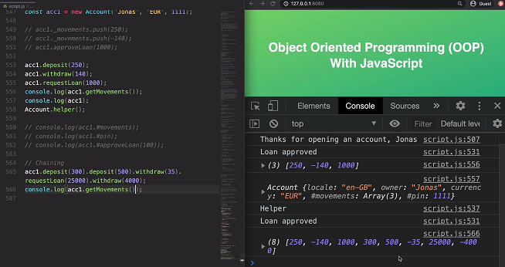
Chaining Methods

